Slide 1

GEOG0114: Principles of spatial analysis
WEEK 1: Introduction to SPATIAL ANALYSIS & DATA SCIENCE
Dr Anwar Musah (a.musah@ucl.ac.uk)
Lecturer in Social and Geographic Data Science
UCL Geography
1

Slide 2
Contents
Problem
Knowledge
Collect
Timetable & Assessment
What will we learn in GEOG0114?
The Beginning: Introduction to Spatial Analysis & Data Science
Model
Wrangle
Explore
2
Notes:
So today we will talk about these items i.e., timetable, assessment…

Slide 3
Timetable and Assessment
3

Slide 4
Timetable
Lecture: North-West Wing, Room 305
(Monday: 04:00pm-05:00pm)
Computer practical sessions*: Bernard Street (40), Room 402
(Thursday: 03:00pm-05:00pm)
*IMPORTANT NOTE: Please bring your own laptops with you to the computer practicals on Thursday
4

Slide 5
Coursework & Assessment
What is the assessment?
Spatial data analysis project which is worth 100%
It is a report (max 3,000 words) + code (R).
The coursework will be released on Reading Week (after Week 5)
The deadline for the coursework is Monday 13th January. The submission instructions will be available on Moodle.
5
Notes:
The assessment will consist of
Report (max 3000 words).
Code (R).
Instructions for executing the code used in the analysis.

Slide 6
What will we learn?
6

Slide 7
What will we learn?
To introduce you to key principles of spatial statistics
Provide an introduction and knowledge of methods for exploring various types of spatial data (i.e., point, areal, line segments and gridded/pixeled data)
You will know how to adopt various spatial analytical techniques for testing out hypothesis, and for addressing problems related to social phenomena and its spatial components.
You will learn to how to apply various families of spatial models (e.g., geographic weighted regressions, Global & Local Moran’s I, Kriging and many more) for making spatial predictions and studying patterns of associations between risk factors and outcomes
You will gain programming skills for carry out data managing, geoprocessing and analysis of spatial data using the software package R/RStudio. You will gain expert knowledge on how to use R/RStudio as a GIS software to perform high-level map visualization
7
Notes:
Introduce to the fundamentals, as well as the key principles, theory and tenets of spatial statistics (and/or) analysis.
- These will cover:
The various spatial data types
How to geo-process such data (aka handling of spatial data)
Methods for accessing spatial dependence in areal-level data
How also learning the various types of spatial analytical methods for evidence-based research

Slide 8
Structure of course
The first part of the module provides foundational knowledge for performing geospatial data analysis with various types of spatial data. In the second part of the module, we will focus on key concepts and methods for dealing gridded data using Raster-based analysis. The third part of the module, we will introduce you to more specialized techniques with real-world applications; and lastly, we will various spatial modelling techniques for evidence-based research.
Part One (Week 1-3): Foundation and theory (i.e., representation of spatial data, geoprocessing and spatial autocorrelation)
Part Two (Week 4-6): Raster-based analysis (i.e., Suitability mapping e.g., AHPs and Niches; and geostatistical modeling using Kriging)
Part Three (Week 7 and 8): Specialized techniques (e.g., Geodemographics and Transport Network Analysis
Part Four (Week 9 and 10) : Spatial regression-based models (e.g., Spatial lag and error models, and Geographically weighted regression models)
Basic principles & visualisation
Geoprocessing
Various spatial analytical techniques
Spatial models
8
Notes:
This is the overarching structure of the course

Slide 9
Breakdown of what will we be learning
Week | Lecturer | Weekly Topics
1 | AM | Spatial Analysis for Data Science
2 | AM | Graphical Representation of Spatial Data
3 | AM | Spatial Autocorrelation
4 | AM | Suitability Mapping: Part I (Qualitative approach)
5 | AM | Suitability Mapping: Part II (Quantitative approach)
Reading Week (Release of Assessment)
6 | AM | Geostatistics using Kriging
7 | JVD | Geodemographics
8 | JVD | Transport Network Analysis
9 | AM | Spatial Models: Part I (Spatial Lag & Error Models)
10 | AM | Spatial Models: Part II (Geographically Weighted Regression)
AM: Anwar Musah | JVD: Justin Van Dijk
9

Slide 10
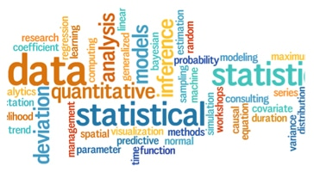
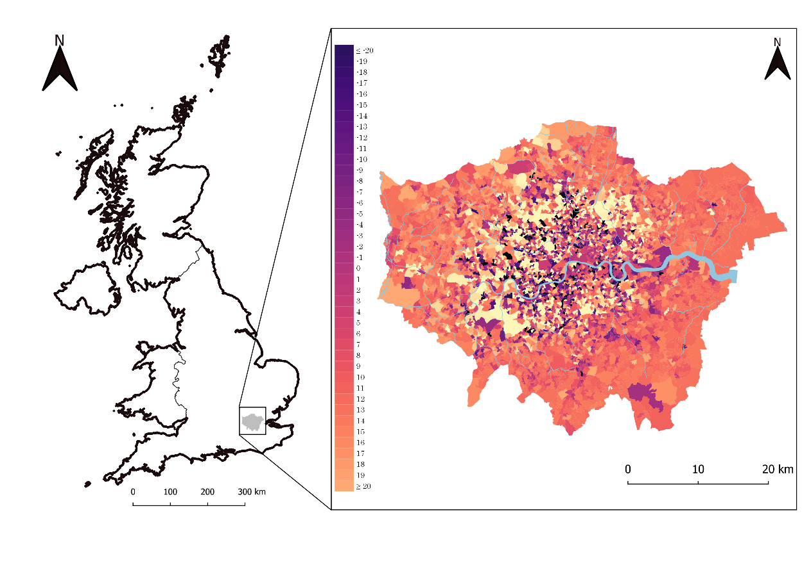


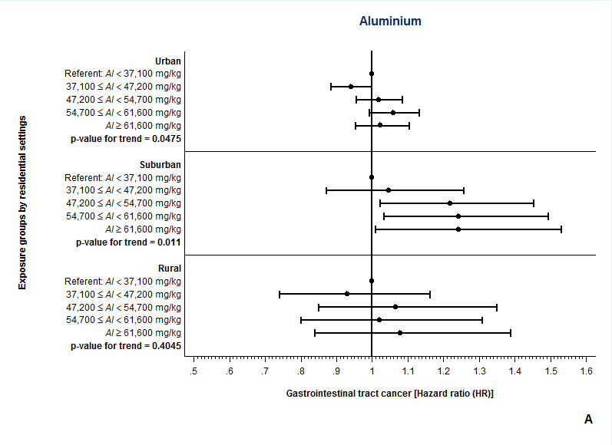

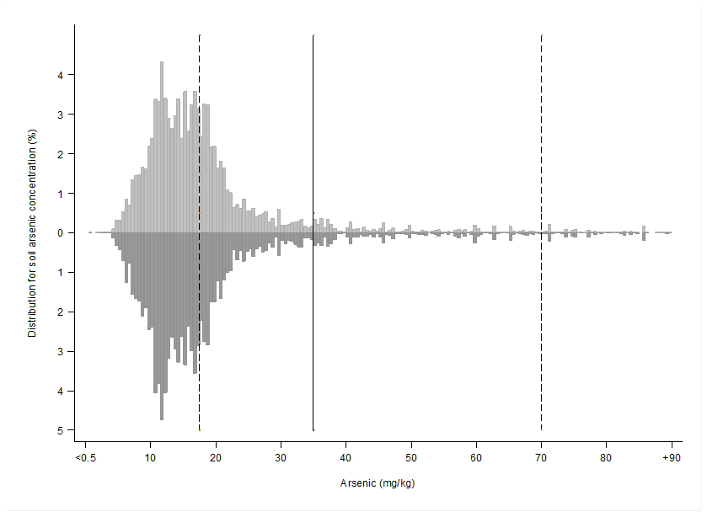
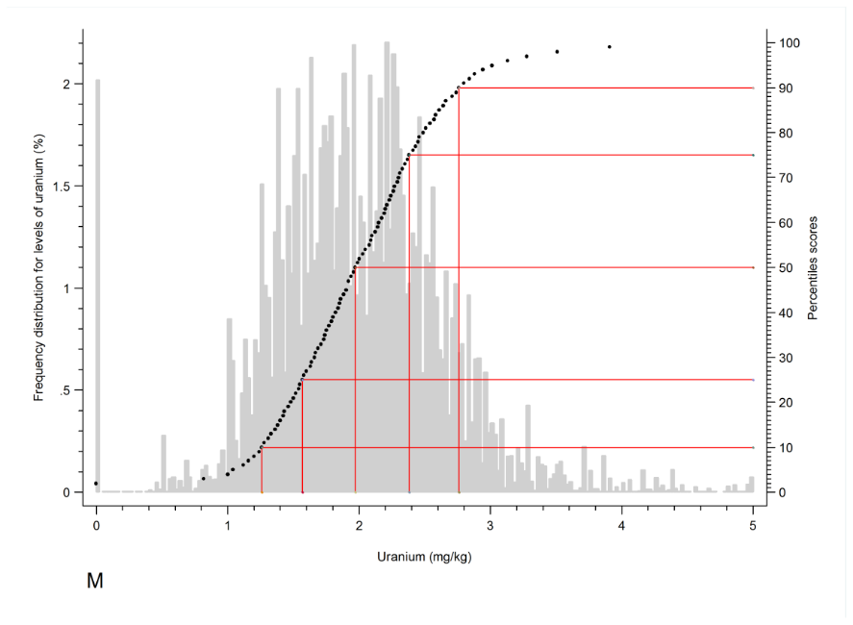
We will be using RStudio throughout the course
10

Slide 11
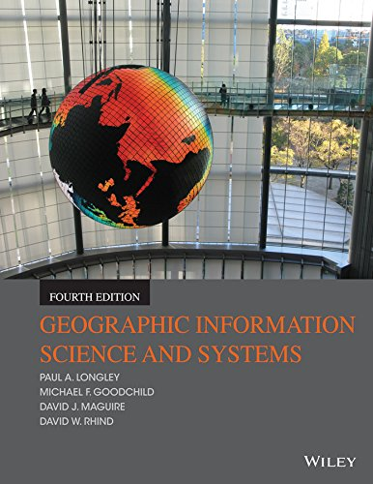
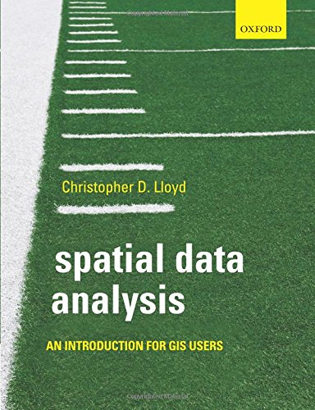
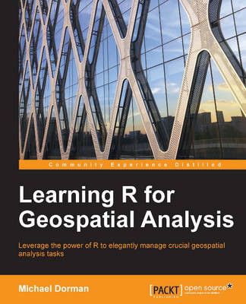
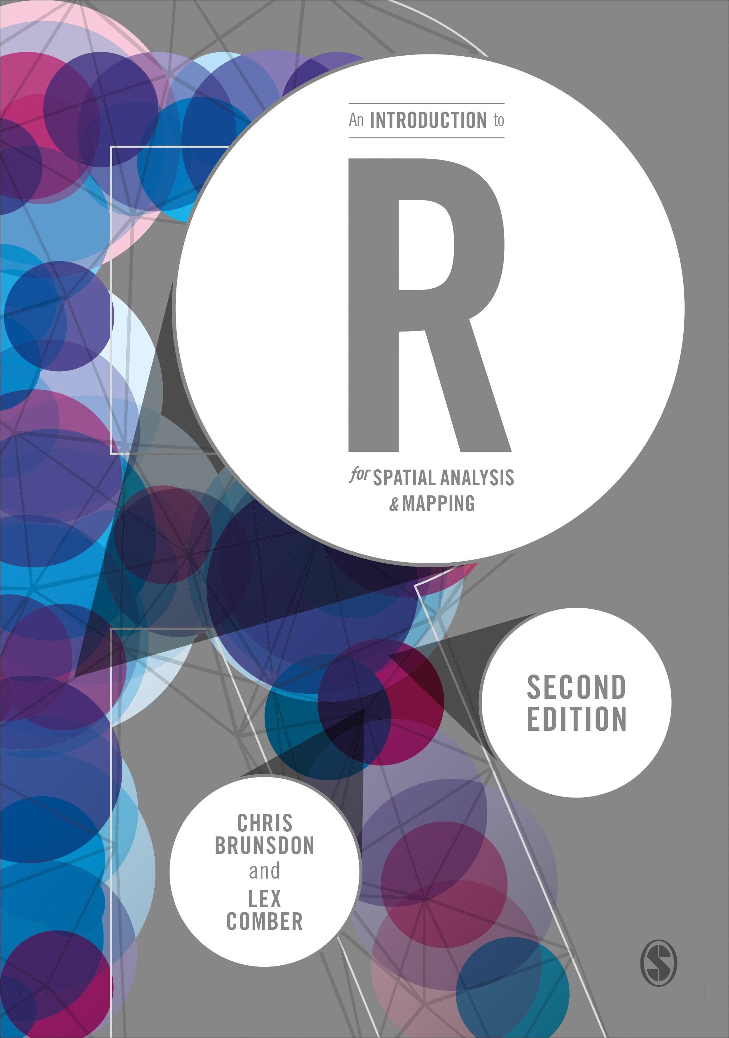
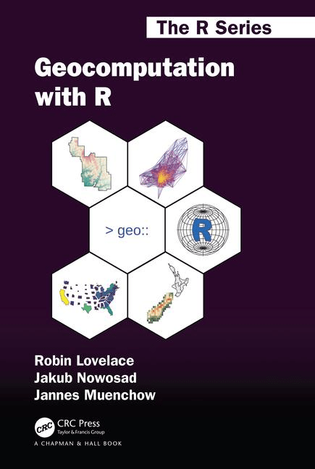
Recommended Books for GEOG0114
High recommendation for the coding experience and execution of spatial analysis in R
High recommendation for the mastery of basic theory and principles of spatial analysis
11
Notes:
These are my suggested books which I recommend

Slide 12
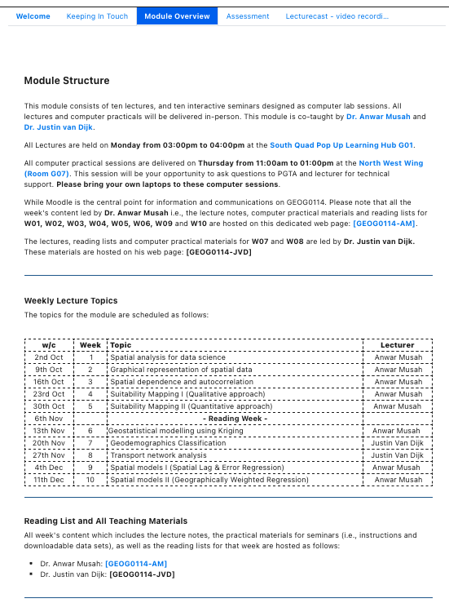
Moodle for GEOG0114 is central point for course and assignment information [https://moodle.ucl.ac.uk/]
Module Overview section is where you can see the timetable and access GEOG0114 GitHub website
Please click on any of these links to be teleported to the GEOG0114 GitHub website.
Here is where the practical and lecture note materials are hosted. Please download as soon as you gain access.
The new lecture notes and practical materials will be released by the end of Thursdays before next week’s Monday’s and Thursday’s lectures & practical session, respectively.
12

Slide 13
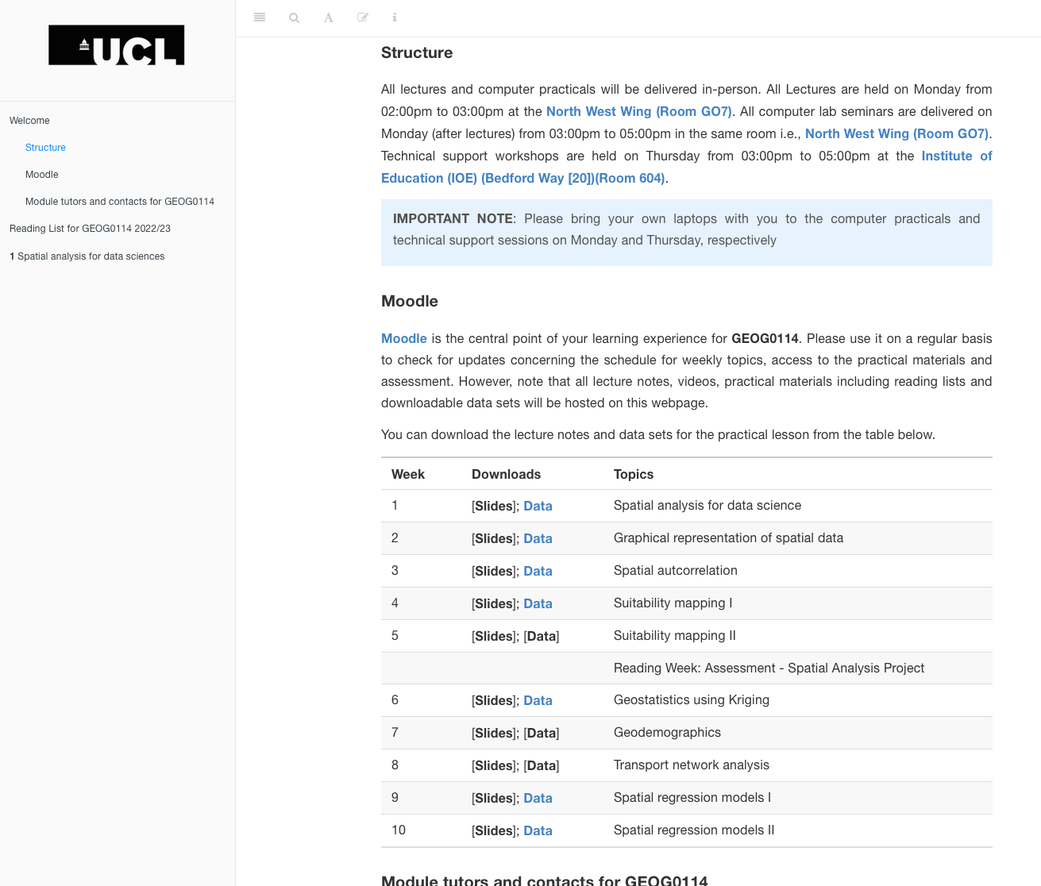
Download the lecture and practical materials for that week
13

Slide 14
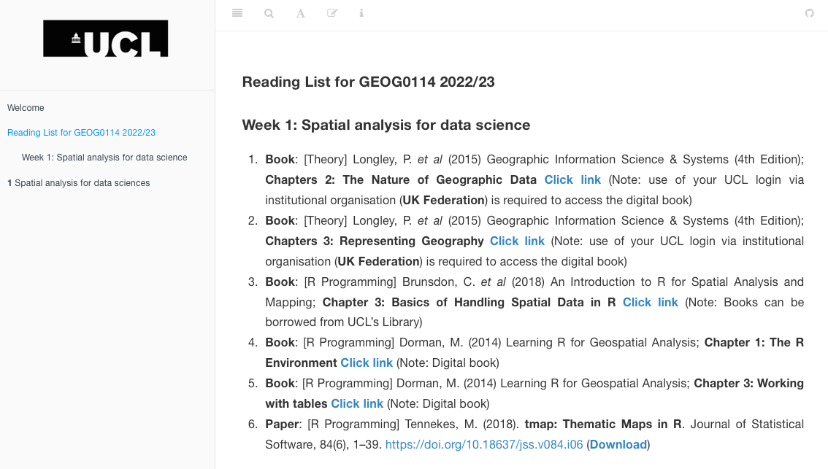
Access to the reading list for GEOG0114 2023/24
14

Slide 15
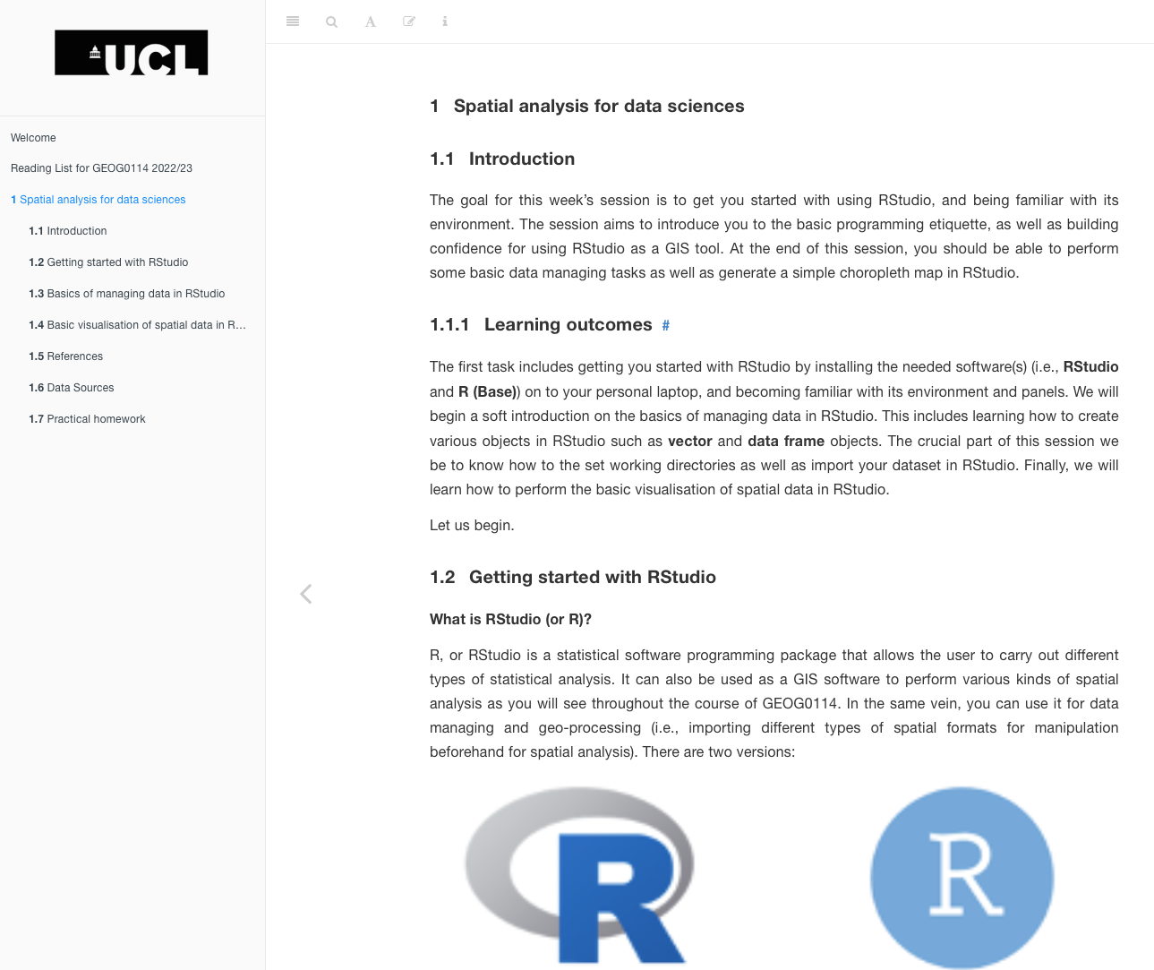
Access to the chapter that actual computer practicals
15

Slide 16
The Beginning: Introduction to Spatial Analysis and Data Science
What is Spatial Statistics (or Analysis)?
16

Slide 17
Definition:
The field of Spatial Statistics (or Analysis) is built on the assertation that nearby geographical observations (or objects) are somewhat associated in someway in space.
The field is interdisciplinary as it brings to together theories from statistics, geography, computer science and integrates evidence-based research methodologies (i.e., study designs)
Usage for describing spatial distribution of areal/point/gridded outcomes, interactions between objects in space, but also how an objects has an impact on other nearby objects.
17

Slide 18
Traditional statistics versus spatial statistics [1]
How does traditional statistics differ from spatial analysis?
The benchmark in traditional statistical theory is the “common” assumption of independence about observations which states that:
“the value of an observation does not influence or affect the value of other observations”
Crude examples:
Assessing the Body Mass Index (BMI) of new enrolled students of GEOG0114
Average test scores from Year 10 mathematics classes from each school
18

Slide 19
Traditional statistics versus spatial statistics [2]
The field of spatial statistics is based on assumption of dependence (or non-independence) of observations
Spatial statistical theory of assumption of dependence (or non-independence) states that:
“…closer observations or nearby units in space are in someway closely related (i.e., similar in characteristics or interact more) than those that are distant from each other…”
The assertion is the “cornerstone” of spatial statistics. It is called:
The First Law of Geography (Tobler, 1979)
19

Slide 20

First Law of Geography [1]
Waldo Rudolph Tobler (1930 – 2018)
Tobler’s First Law of Geography on “everything is related to everything else, but near things are more related to distant things”
This first law is the foundation of the fundamental concepts of spatial dependence. It is integrated to most of the families of models in spatial statistics
Very important concepts to keep in mind when you think about spatial dependence:
Spatial Autocorrelation
Distance Decay
Spatial Spillover
20

Slide 21
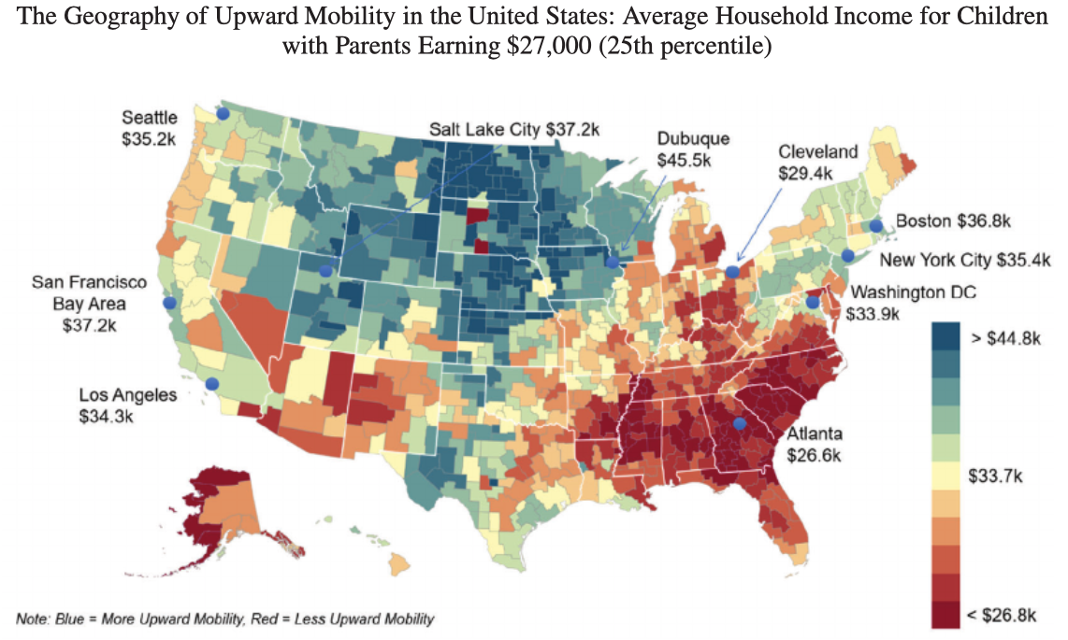
What is Spatial autocorrelation in the context of Tobler’s theory?
“This simply refers to whether (or not) similar values cluster together over geographic space”
Etymology (“Auto” means self; and “correlation” means the degree of relative correspondence)
Similar values that cluster together are said to have positive spatial autocorrelation (& spatially dependent)
Random patterns or values that cluster together are said to have no spatial autocorrelation (and thus no dependence)
Positive
No patterns
Positive
Spatial dependence and autocorrelation, particularly in areal data, will be covered in-depth in Week 3
21

Slide 22
What is Distance decay in the context of Tobler’s theory?
“This refers to the distance between two events (or objects) and their degree of interaction in space as distance vary.”
In short, what distance decay (in the context of Tobler’s theory) says:
It dictates how objects interact. The larger the distance between two events in a space – the less is their interaction & vice versa
Examples of where Distance decay manifests in studies cities and urban space:
As distance from the focal point of a city center increases – high population density, taller buildings, and accessibility to multiple modes of transport decreases
Housing marketing – house prices decreases, and in turn, residential mobility increases from expensive to affordable areas
22

Slide 23
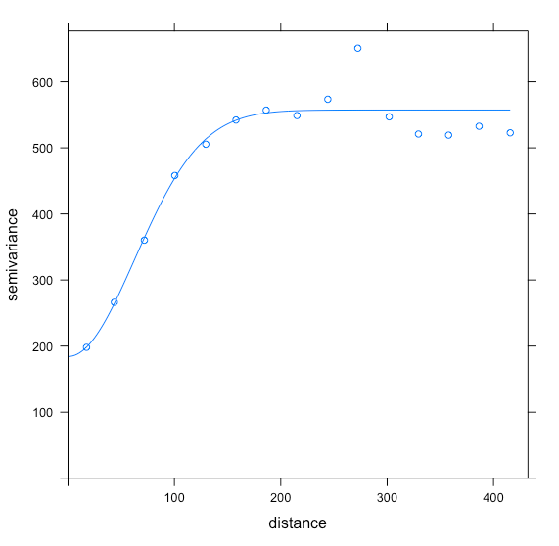
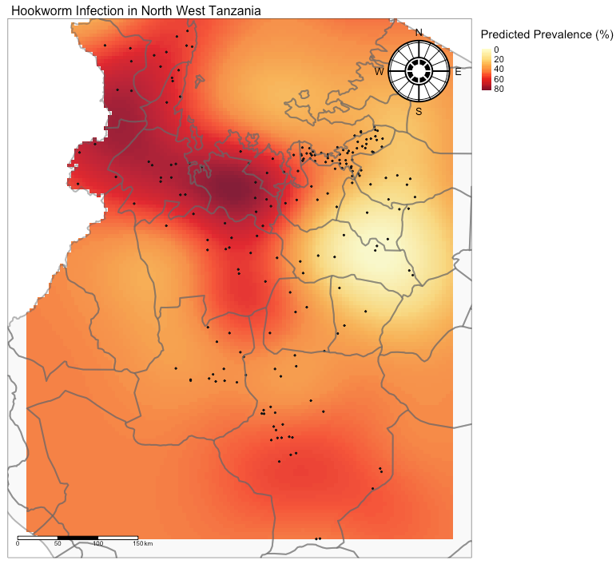
Using Kriging to spatially predict areas with intense hookworm infection associated with socioeconomic deprivation in Northwestern Tanzania
Spatial dependence and autocorrelation, particularly in point (geo-statistical) data, will be covered in-depth in Week 6
Below 180km
Over 180km
Villages with hookworm
prevalence with separation
distance below 180km have similar prevalence
Villages with hookworm
prevalence with separation
distance 180km and over don’t
have related prevalence
We have survey points (of villages) reporting prevalence of hookworm in Northwestern Tanzania. We assumed there some spatial dependence in the prevalence of hookworm in these locations to predict prevalence where there are no information (or points). We use this information on form the left panel to build our model for making geostatistical predictions.
We used the concept of distance decay, or in this
‘separation distance’ to account for spatial dependence
between our survey points
23

Slide 24
Spatial Spillover: “…where you are in geographic space matters” an event in one location can someway have an impact on other events in neighboring areas
In Spatial Statistics, especially in Spatial Regression, Geostatistics – we often try to account for spatial spillover effects in our models
There are four types of spillovers:
No spillover
Local spillover
Global spillover
Rippling spillovers
24

Slide 25
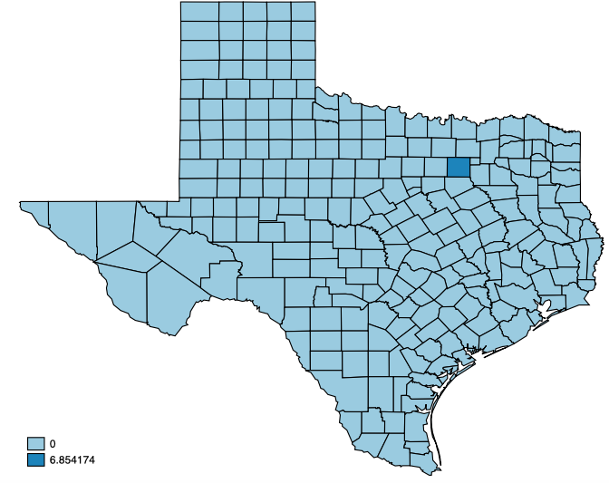
Spatial Spillover: “…where you are in geographic space matters” an event in one location can someway have an impact on other events in neighboring areas
In Spatial Statistics, especially in Spatial Regression, Geostatistics – we often try to account for spatial spillover effects in our models
No spillover (independence)
A change in unemployment in that dark blue area will only have an impact on crime rates within its own area, but does not influence crime rates in neighboring areas
25

Slide 26
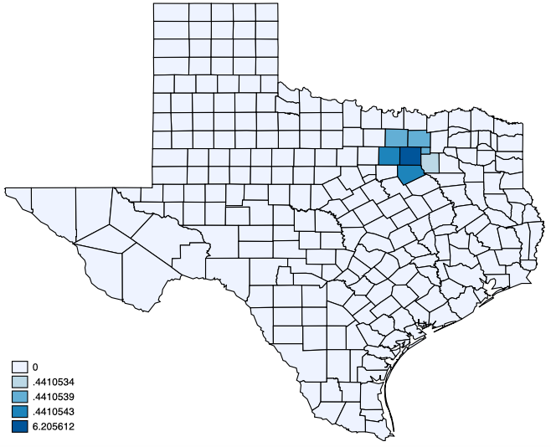
Spatial Spillover: “…where you are in geographic space matters” an event in one location can someway have an impact on other events in neighboring areas
In Spatial Statistics, especially in Spatial Regression, Geostatistics – we often try to account for spatial spillover effects in our models
Local spillover (dependence)
A change in unemployment in that dark blue area (in the center) will not only have an impact on crime rates within its own area, but it will also have a direct influence on crime rates in neighboring areas only.
26

Slide 27
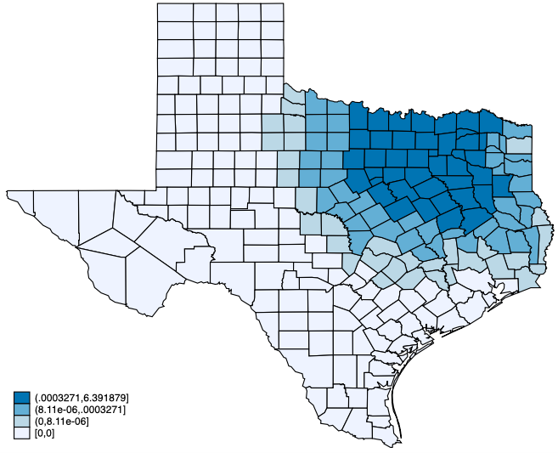
Spatial Spillover: “…where you are in geographic space matters” an event in one location can someway have an impact on other events in neighboring areas
In Spatial Statistics, especially in Spatial Regression, Geostatistics – we often try to account for spatial spillover effects in our models
Global spillover (dependence)
A change in unemployment in that dark blue area (in the center) will not only have an impact on crime rates within its own area, but it will also have a wider influence on crime rates beyond its direct neighbors.
27

Slide 28
Spatial Spillover: “…where you are in geographic space matters” an event in one location can someway have an impact on other events in neighboring areas
In Spatial Statistics, especially in Spatial Regression, Geostatistics – we often try to account for spatial spillover effects in our models
Rippling spillover (dependence)
Where there is a focal point for an event and its influence may have a rippling (or trickle down) effect across space, triggering other events, which then diminishes with time and distance.
e.g.,
Natural disasters - an earthquake and building destruction.
Disease spread and outbreaks
World financial markets and crashes
Spatial dependence in spillovers, particularly in areal data from a modelling approach, will be covered in-depth in Week 9
28

Slide 29
What is Spatial Data & its Features?
29
Notes:
Spatial data is any entity that has information about its geographic attributes
- There are 3 types of data
1.) Point patterns
2.) Aggregated/Area-based data
3.) Geostatistical data

Slide 30
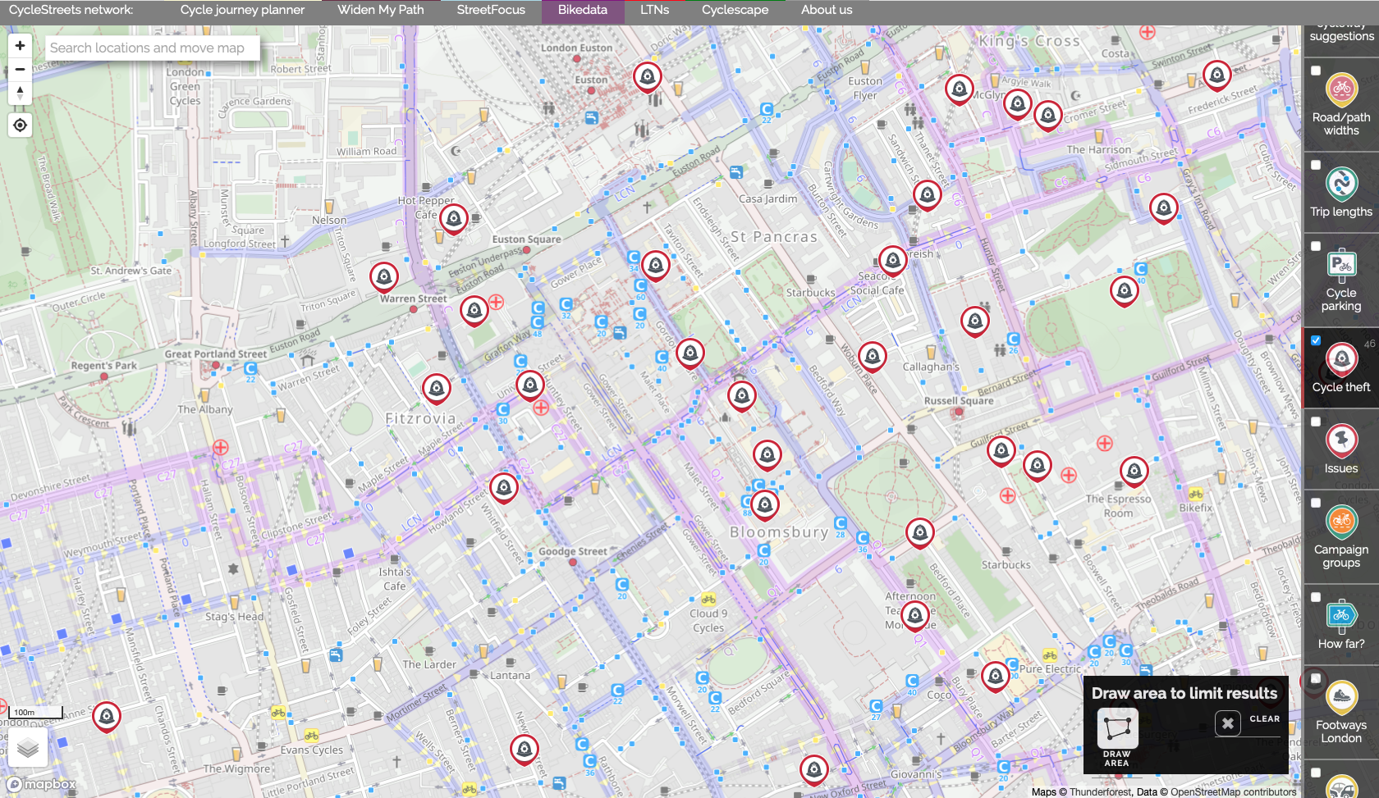
Point Pattern Data (PPD)
Key Characteristics
The main interest is the occurrences of an event at a points (or points). These events occur at “random” at any given geographic space and time.
Examples of PPDs events (or outcomes):
Point locations of burglaries
Riots
Locations of car collisions etc.,
Locations of where an adult tree needs to be replanted
Some PPDs events may carry additional information that may describe the occurrence of an observed event (or outcome):
Burglary: Type of premise that was burgled, time of day the burglary occurred etc.,
Car collision: type of road, weather condition etc.
Represents point locations of bicycle thefts in Central London area
Source: BikeData.CycleStreets network https://bikedata.cyclestreets.net/
30

Slide 31
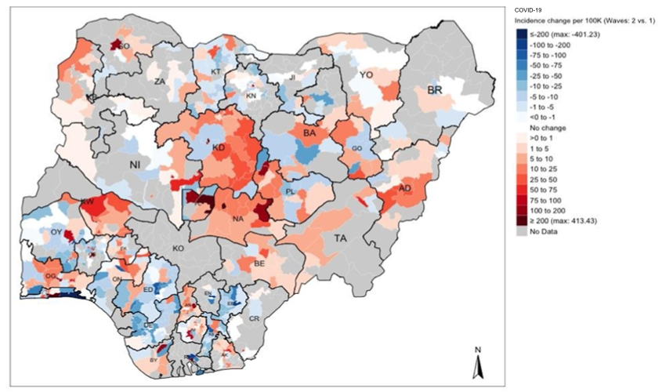
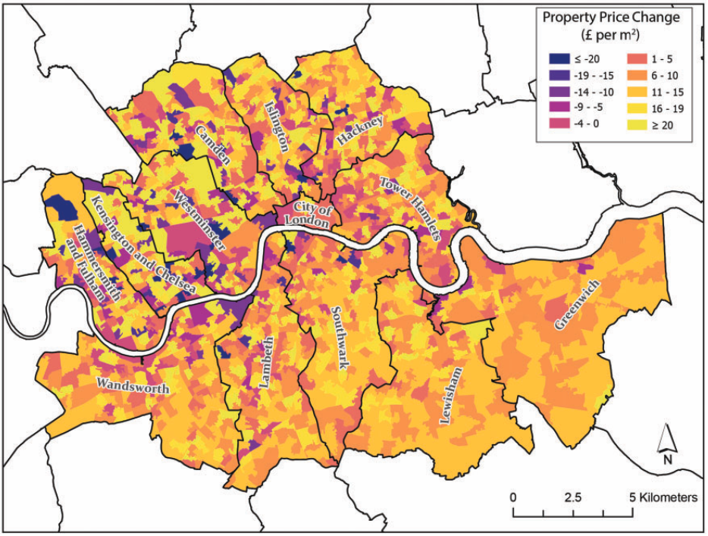
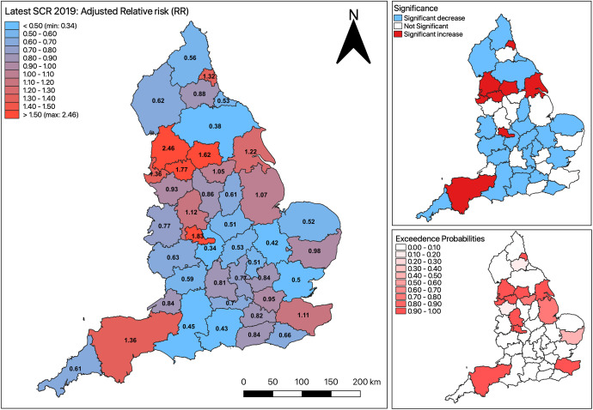
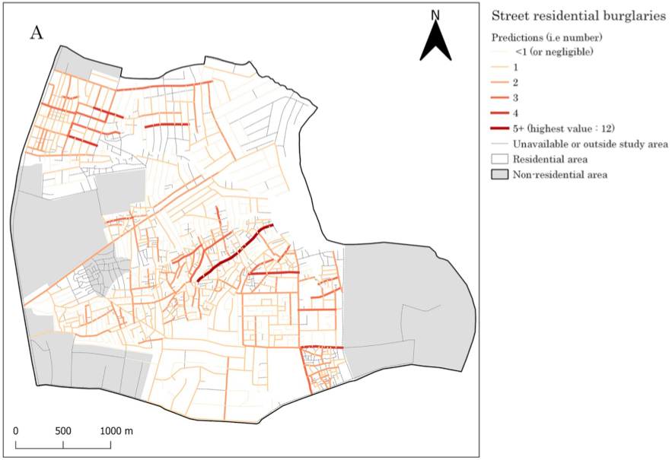
Aggregated Data
Key Characteristics
The main interest the quantity of interest defined for line segments, areas, or regions.
Events (or outcomes) that are aggregated measures to areas:
Prevalence of a disease in areas
Population density in a county
Regional unemployment rates
Risk of an outcome
Sources:
Musah, A., et al. (2020): https://doi.org/10.1016/j.apgeog.2019.102126
Todd, J., et al. (2021): https://doi.org/10.1177/23998083211001836
Li, L., et al. (2022): https://doi.org/10.1016/j.apgeog.2022.102718
Elimian, K., et al. (2022): http://dx.doi.org/10.1136/bmjopen-2022-063703
31

Slide 32
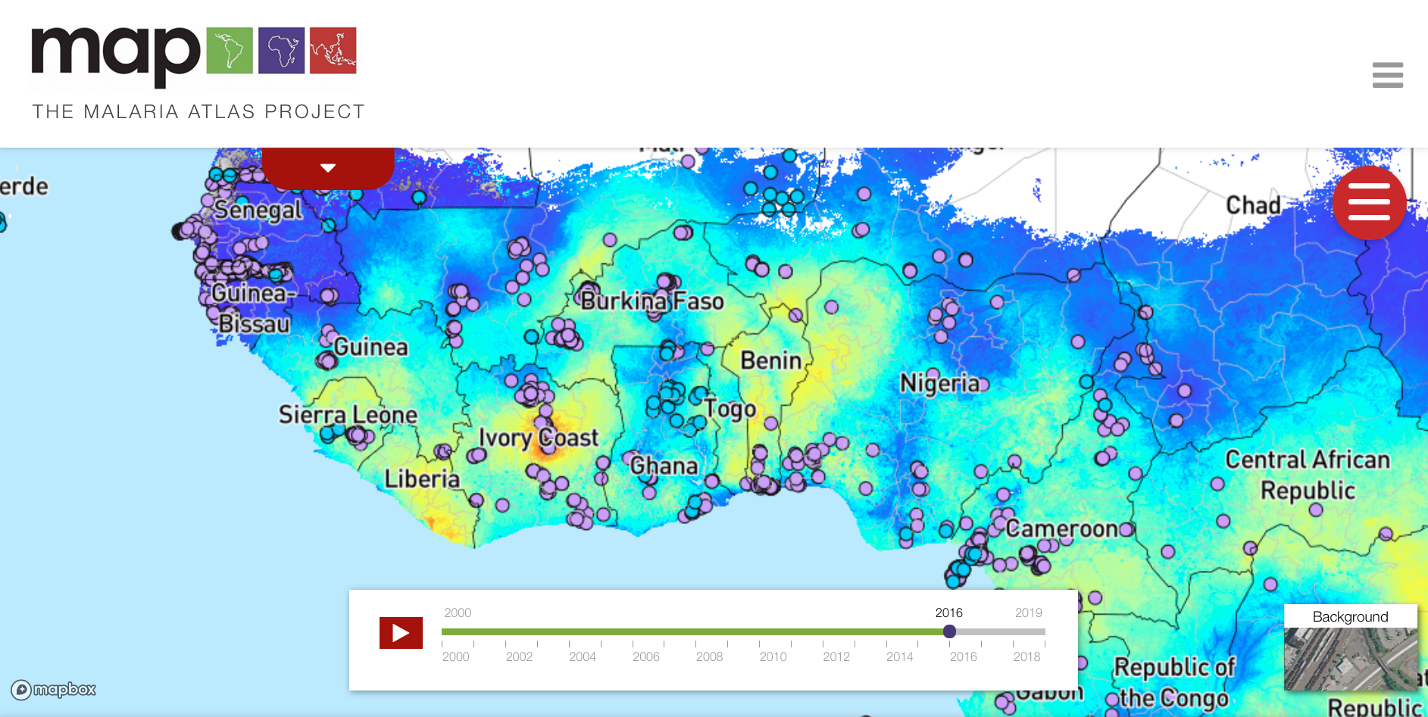
Geostatistical Data
Key Characteristics
The quantity of interest has a value at any location across a given area.
These are values over a grid/raster
Events are usual statistical prediction determined from “sampled” points with continuous data values:
Land surface elevation
Diffusion of ambient air pollutants
Environmental suitability for breeding habitats of mosquitoes
Community surveys pertained to disease burden
Sampled points are surveys on prevalence of malaria, which were used to make survey predication of prevalence at unsampled areas in Sub-Saharan Africa
Source: The Malaria Atlas Project https://malariaatlas.org
32

Slide 33
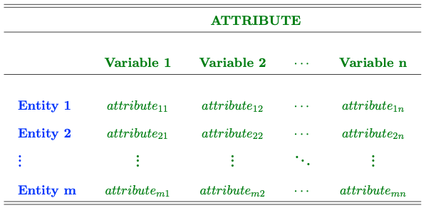
Non-spatial context & data structure:
Attributes that defines an entity’s location are typically excluded from the analysis
The conventional statistical methods, that assumes independence, are used for analyzing such dataset
Results churned from this dataset are completely independent from “spatial arrangement” of the entities.
To apply some spatial analysis to data – you must have some variable that defines the entity’s geographic location. This can be GPS coordinates, spatially referenced geometries of an area
NOTES: It is not enough to have the just the name of the area(s). It must be some geometric entry!
33

Slide 34
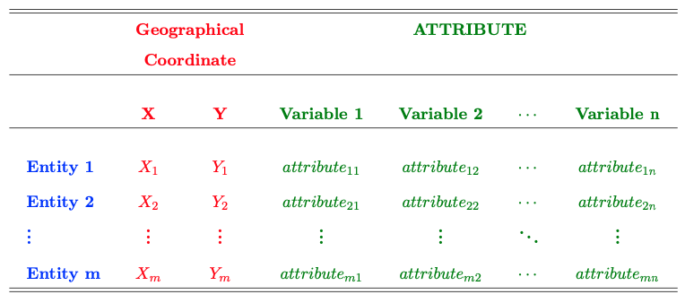
Spatial context & data structure:
Attributes that defines an entity’s location are typically explicitly incorporated into analysis
Spatial statistical methods, that assumes dependence, are used for analyzing such geographically referenced dataset
Results churned from this dataset are completely dependent from “spatial arrangement” of the entities.
In this example, what defines the entity’s geographic location are X, Y GPS coordinates.
Definition of an entity’s location are not limited to coordinates, you can have spatially reference areas with their associated boundaries with geometries.
This instance illustrates an example of geostatistical data.
34
Notes:
If area, you will have the area name that defines the geographical entity
If line segment, a series of points connecting to form a line segment that defines the geographical entity etc.

Slide 35
Geographical Information Systems (GIS)
35

Slide 36

Roger F. Tomlinson (1933 – 2014)
He is an English geographer and computer scientist, who is revered as the “Father of GIS”
His PhD research titled: “The application of electronic computing methods and techniques to the storage, compilation, and assessment of mapped data” (1962, @UCL)
Conceived the idea of analyzing multiple layers of spatial data within a single environment
Geographical Information Systems (GIS), which is now a software, grown into a billion-dollar industry
36

Slide 37

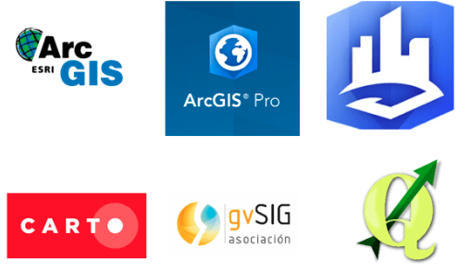

37

Slide 38
38

Slide 39
R (Standard)
RStudio (Best)
There are two version of the software: 1.) R, and 2.) RStudio; The second is much preferred as its straightforward and intuitive.
39

Slide 40
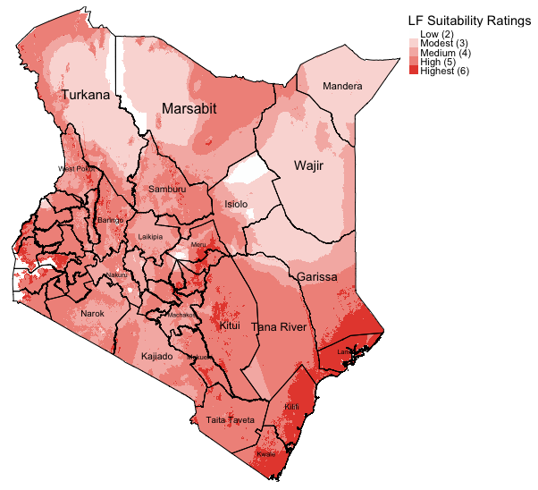


Why are we teaching RStudio?
Flexible and provides access to powerful packages for analysis
Impressive graphs, visualizations and maps
Excellent statistical capabilities too
Example: Map generated in R to illustrate areas that are environmentally suitable for the spread of neglected tropical disease called ‘Lymphatic Filariasis (LF)’ in Kenya.
Sources:
1. Global Atlas for Helminths Infection (http://www.thiswormyworld.org)
2. ESPEN (https://espen.afro.who.int)
40

Slide 41
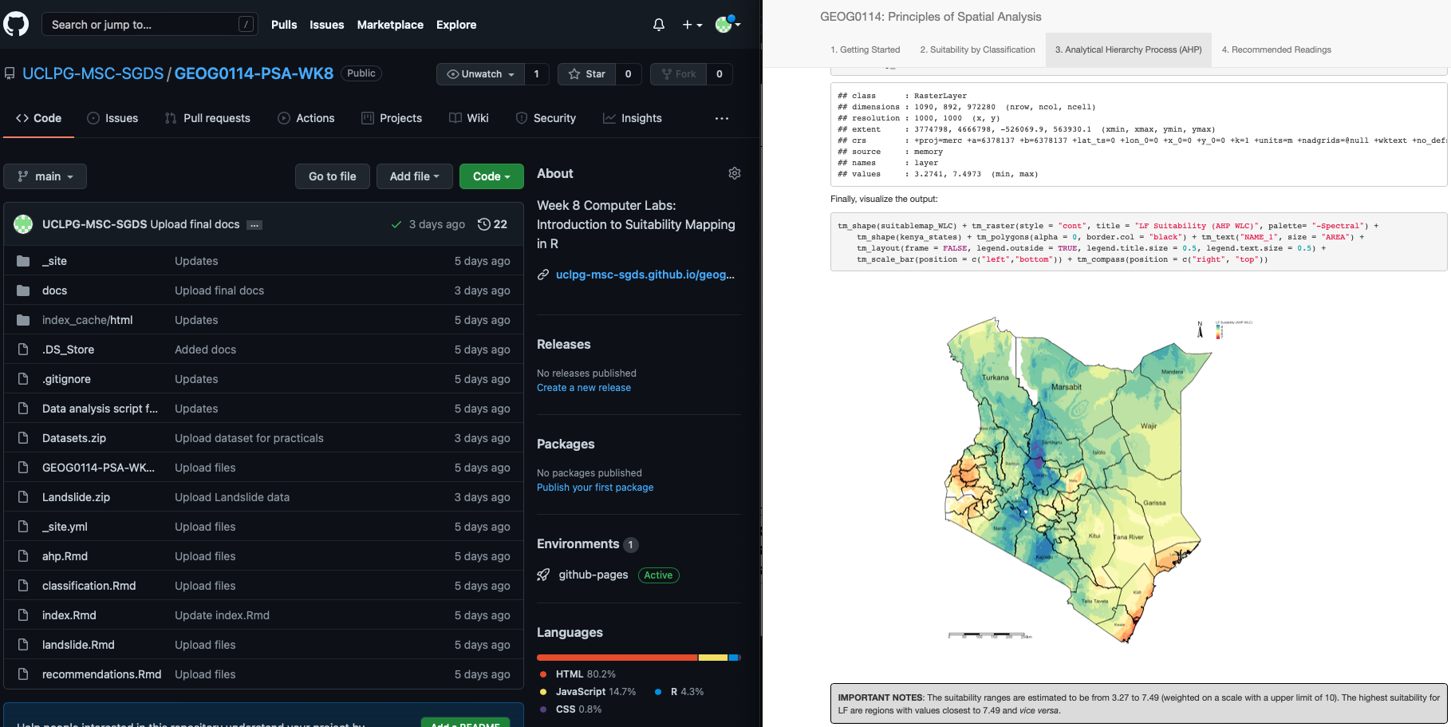
… and why learn how to code in RStudio?
Efficiency
Automated tasks and data managing
Can recycle & reuse code scripts for new projects
2. Fosters good scientific practice
Transparency and replication (AKA reproducible research)
Creates log so anyone can follow in your footstep (i.e., github, gitlab etc.,)
You can literally pull-off some really creative stuff like generating websites, accessing tools via APIs etc.
Example: Working in RStudio and synchronising it with GitHub to not only use as a cloud back-up, but to generate a website through RStudio and GitHub for teaching MSc Students.
Sources:
GitHub (https://github.com)
41

Slide 42
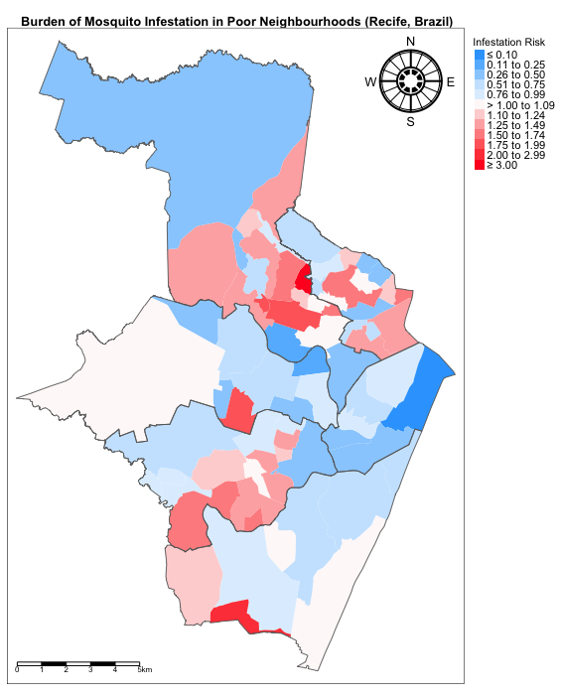
Example of a basic code structure in RStudio
# comment: activate packages for performing GIS in R library("sf") library("tmap") # comment: add neighbourhood shapefile w/mosquito infestation data using read_sf() recife.neighbourhoods <- read_sf("Recife_neighb_epsg3857_fixed.shp") recife.healthzone <- read_sf("Recife_regions_epsg3857_fixed.shp") # comment: assigning labels for the risk estimate legends RiskCategorylist <- c(”\u2264 0.10", "0.11 to 0.25", "0.26 to 0.50", "0.51 to 0.75", "0.76 to 0.99",">1.00 to 1.09", "1.10 to 1.24", "1.25 to 1.49", "1.50 to 1.74", "1.75 to 1.99", "2.00 to 2.99", ”\u2265 3.00") # comment: generating the divergent color scheme from Blues to Red spectrum RRPalette <- c("#33a6fe", "#65bafe", "#98cffe", "#cbe6fe", "#dfeffe", "#fef9f9", "#fed5d5", "#feb1b1", "#fe8e8e", "#fe6a6a", "#fe4646", "#fe2424", "#fe0000") # comment: map of risk of infestation tm_shape(recife.neighbourhoods) + tm_fill("RelativeRiskCat", style = "cat", title = "Infestation Risk", palette = RRPalette, labels = RiskCategorylist) + tm_shape(recife.healthzone) + tm_polygons(alpha = 0, border.alpha = 0.90) + tm_layout(frame = TRUE, main.title = "Mosquito Infestation in Neighbourhoods (Brazil)", main.title.size = 0.8, main.title.position = 0.02, main.title.fontface = 2, legend.outside = TRUE, legend.outside.position = "right", legend.title.size = 0.8, legend.text.size = 0.7) + tm_scale_bar(position = c("left", "bottom")) + tm_compass(type = "radar", show.labels = 2, position = c("right", "top"))
42

Slide 43
Summary
The take home message is:
Spatial statistics is grounded on spatial dependence, drawn from Tobler’s 1st Law of Geography
Fundamental concepts for explaining spatial dependence – are three key words: Spatial autocorrelations & Distance decay effect, and spatial spillovers.
Spatial data and data structure – three types: areal/regional data, point patterns and geostatistical
Two important people to commit to memory: Dr Waldo Tobler (1st Law of Geography) and Dr Roger Tomlinson (Father of GIS)
Best GIS packages are usual the ones that are FREE (i.e., R/RStudio for its packages that enable GIS functionality, and QGIS)
43

Slide 44
Any questions?
44

